Slide 1


Slide 2
Agenda
Data Preprocessing
Exploratory Data Analysis
Build a Recommmendation System
Conclusions

Slide 3
Data Preprocessing
Convert date appropriate format
Transform all columns which had json string into json format
Create director writer and producer columns
Create profit column
Fill some missing values by most frequent one

Slide 4
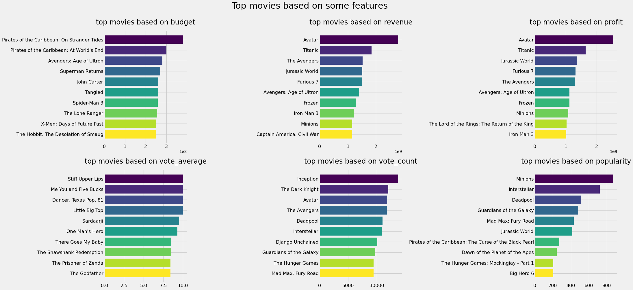
Exploratory Data Analysis
Top movies based on budget, revenue and profit

Slide 5
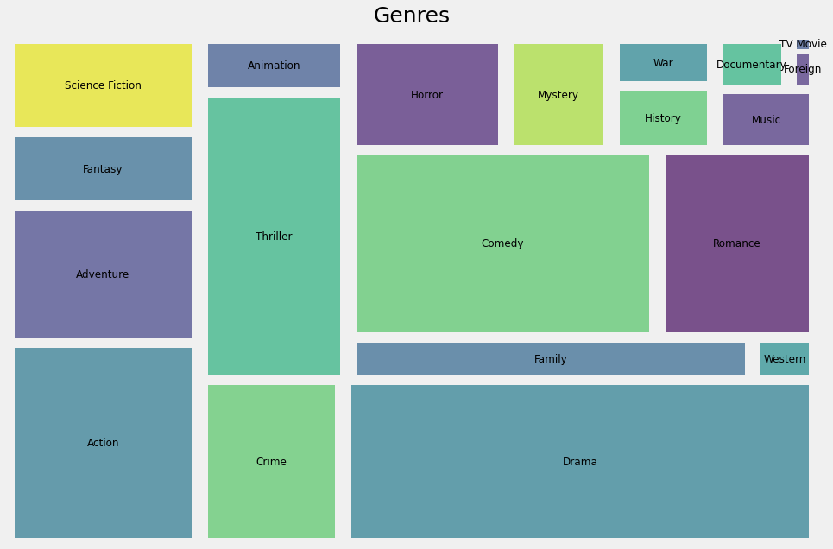
Exploratory Data Analysis
What types of Movies?

Slide 6
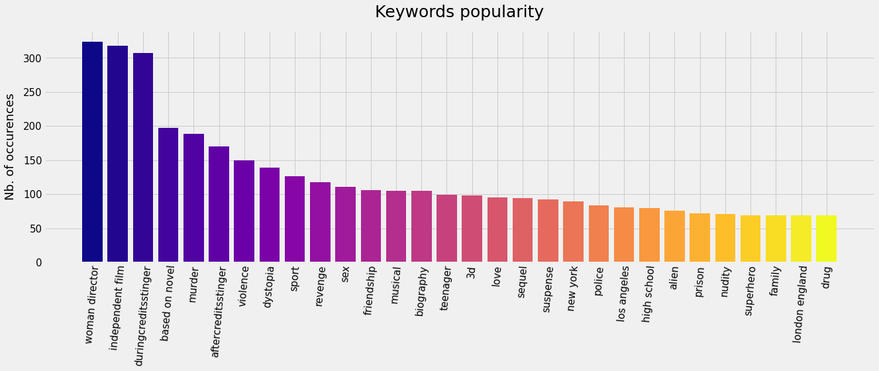
Exploratory Data Analysis
What is the reason of popularity?

Slide 7
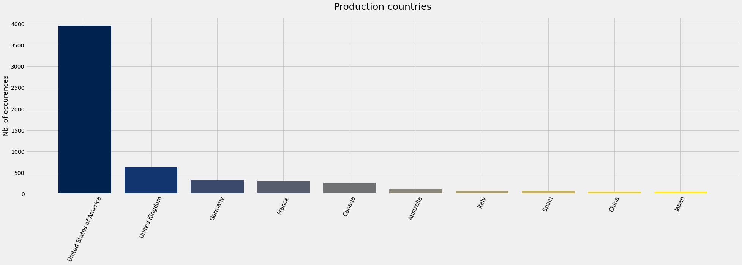
Exploratory Data Analysis
Top Countries Based on Production

Slide 8
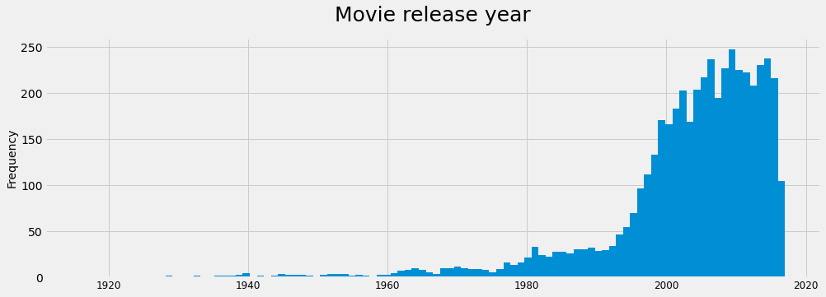
Exploratory Data Analysis
Which year movies release most?

Slide 9
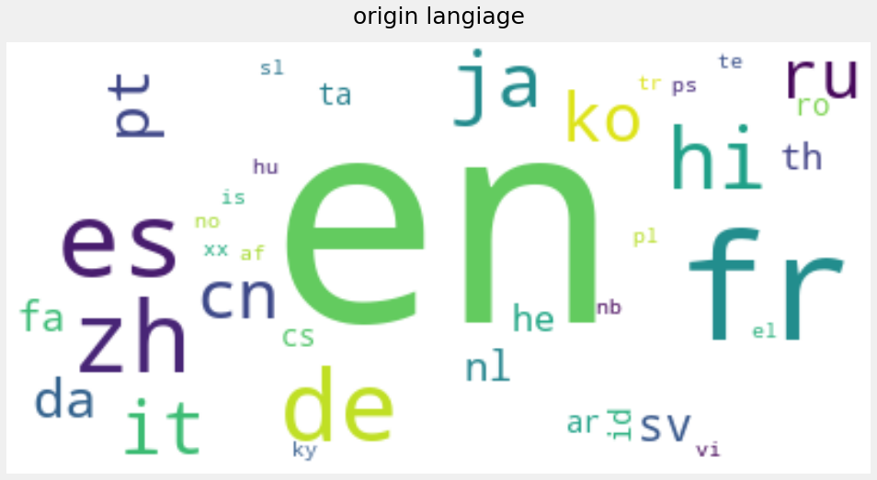
Exploratory Data Analysis
Which languages most used?

Slide 10
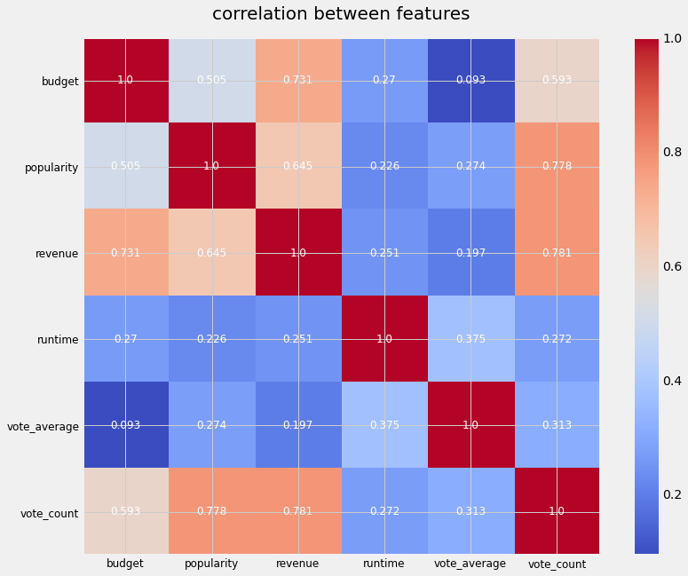
Exploratory Data Analysis
Which Feature is most Correlated?

Slide 11
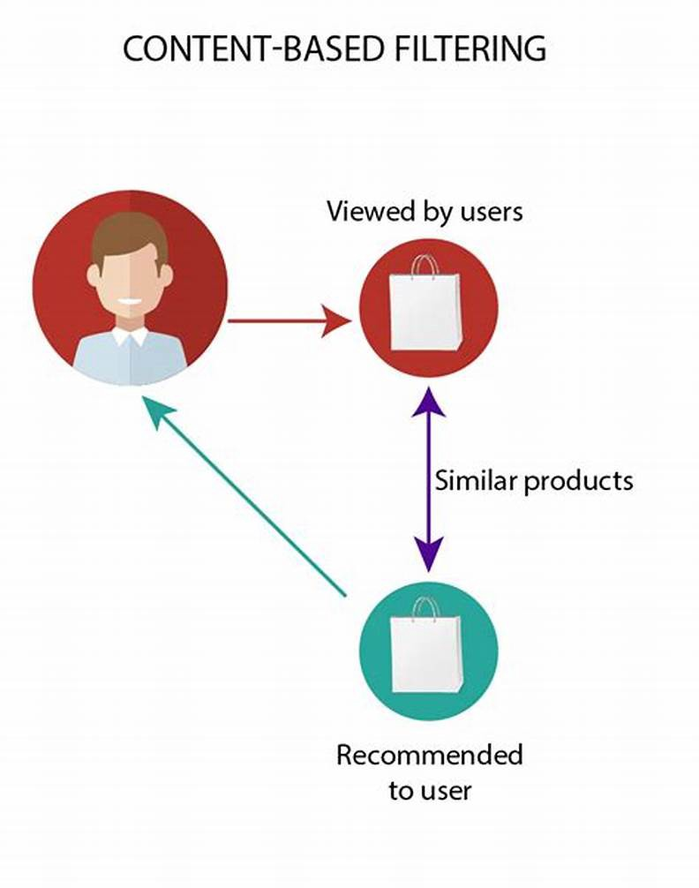
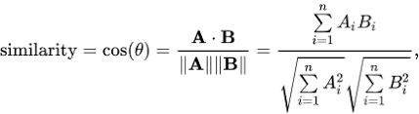
Recommendation System
A content-based recommendation system suggests items to a user based on the characteristics of items that the user has previously liked or interacted with
The system creates a profile of the user's preferences and uses this profile to suggest similar items.
In this method we calculate the cosine similarity between the item's feature and the user's profile, so that system can recommend items that are similar to the items that the user has liked in the past.
Source: https://miro.medium.com/max/792/1*P63ZaFHlssabl34XbJgong.jpeg

Slide 12

Recommendation System
Weighted Average
In a content-based recommendation system, a weighted average is used to combine the user's preferences for different features of an item.
The weight for each feature determined through user feedback.
v is the number of votes for the movie;
m is the minimum votes required to be listed in the chart;
R is the average rating of the movie;
C is the mean vote across the whole report

Slide 13
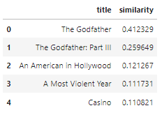
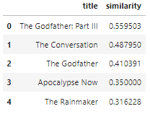
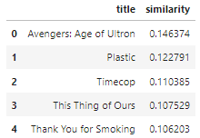
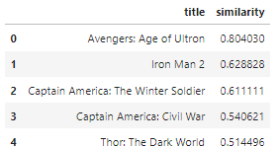
Comparison of two methods
TF-IDF
Bag-of-words
The Godfather: Part II
The Avengers

Slide 14
Conclusions
In summary, building a content-based recommendation system using the Bag of Words (BOW) model can be effective.
The BOW model has proven to perform well in this context, so it should be considered as a viable option when implementing a content-based recommendation system.

Slide 15
Thank you for your attention!

